Slide 1
Seeking Applicants for Full Time Fire Chief
Glen Carbon Fire Protection District

Slide 2
Background and History
The Glen Carbon Fire Department was organized on July 21, 1901 as the Glen Carbon Chemical Fire Company No 1. The department, housed in the Old Village located atop the hill at the corner of School Street and Summit Avenue, consisted of 22 members and a handcart with 600 feet of 2-1/2 inch hose. The location of the building was ideal as it was located on one of the highest points in Glen Carbon allowing the bell, located on top of the building and used to alert the firemen, to be heard for miles. In 1921 the department purchased its first mechanized truck, a Ford Model-T pumper with 500 feet of hose. In 1941, the department was able to update this first equipment with a Dodge truck pumper purchased from the Central Fire Truck Company. Now long removed from service, Fire Safety, Inc. Located in Wood River, Illinois, purchased the truck in 1985. The truck is still available today for the fire department to use for special events.
In 1956 the department reorganized as the Glen Carbon Fire Protection District. Bernard Birger, Nick Hamilos, and Albert Miller were appointed as the first trustees. That same year land was purchased on Main Street near the site of the old village ball diamond.
A new firehouse (Station 1) was built and occupied by the Glen Carbon Volunteer Fire Department, now Company No. 2.With the population and needs of the fire protection district steadily growing, so also were the department's equipment and services. In 1957 a new GMC 750 g.p.m. truck was purchased. In 1967, to aid in fighting brush and grass fires, a Ford 750 g.p.m. front-mount pumper was added to the fleet bringing the number of on-line pumpers to three.
With the growth of Glen Carbon and the development of the Cottonwood area, it became apparent that a second engine house was needed to meet the demands of this growth. In 1981 property owned by Farm Service on Glen Carbon Road near the intersection of Route 159 was purchased and the building was converted to serve as Station 2. The original building has now been removed and a new Station 2 constructed. This new 3-bay station has been designed and built to meet the long-term needs of the department and includes some of the latest in electronic technology.
Today, the equipment operated by the department includes a 1982 Ford 750 g.p.m. pumper, a 1987 Chevrolet medium-duty rescue truck, a 1993 1000 g.p.m. E-One pumper, a 1991 4-wheel drive Ford fire/rescue truck equipped with a 250 g.p.m. slid-in pump and a 1998 E-One 75 foot aerial truck. All of the pumpers are classified \"Class A\" pumpers.

Slide 3
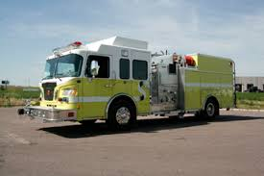
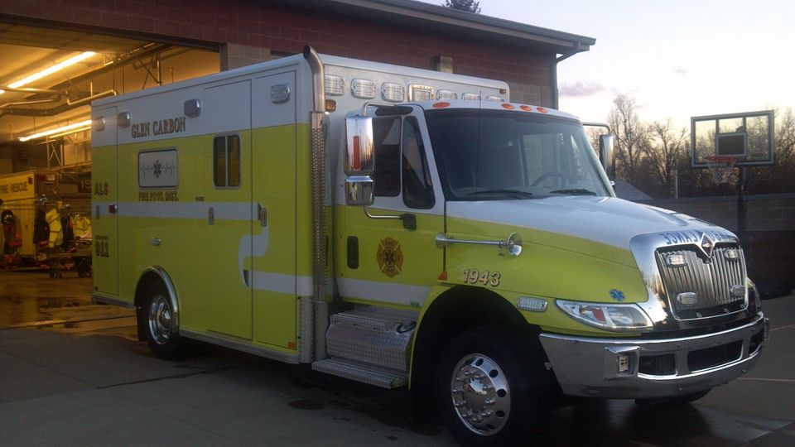
Manpower
Fire Department consists of 30 Paid on Call Firefighters
EMS Department consists of 9 Full Time and 20 Part Time Paramedics

Slide 4
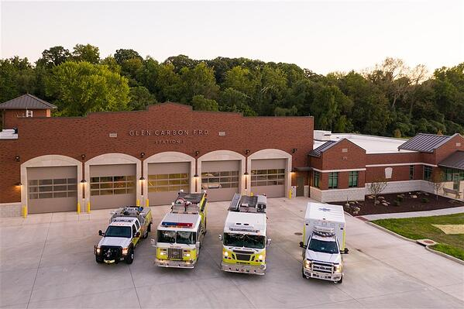
Stations
The Glen Carbon Fire Protection District encompasses 2 Fire Stations for emergency response

Slide 5
Demographics
Glen Carbon Fire Protection District
Population of 12,845
Median Household Income $83,505
Median Property Value $217,500
Median Age 40 years old
Average time travel to work 24 minutes

Slide 6
Goals for the District:
The Glen Carbon Fire Protection District is seeking a Fire Chief who posses the ability to establish unity of the department while placing an emphasis on training, communication, proper reporting, and decreasing response times within the District.
The Chief will report to the Board of Trustees while working with his administrative staff to develop and operate within an annual budget, select subordinate officers, and delegate responsibilities.
The Chief will be visible throughout the District on a daily basis and will respond to all significant incidents within the District. The Chief will serve as the Incident Commander and must be current with the NIMS and Unified Command systems.
The Chief must be comfortable speaking to their staff, the Board of Trustees, the residents of the District, political leaders, group leaders, and be willing to engage with the public at Community Events and Public Meetings.

Slide 7
Candidate Qualifications
The ideal candidate shall demonstrate all technical aspects of emergency scene management (NIMS) (ICS), Emergency Medical Services (ALS and BLS) leadership/management and transport, fire prevention and public education programs, and MABAS (Mutual Aid Box Alarm System) operations. Experience with Labor/Management relations preferred. Ability to collaborate with city, county, and state agencies and elected officials, to arrive at the most effective and efficient resolutions to incidents and challenges within the community. Previous experience in strategic planning is a plus.
The successful candidate will have a minimum of ten (10) years firefighting experience. Three (3) years of command / management experience, Illinois Basic Operations Firefighter, Fire Service Instructor I, Company Fire Officer, demonstrated financial and budgetary skills, as well as a minimum of an EMT License through the Illinois Department of Public Health.

Slide 8
Compensation and Benefits
Salary range is negotiable based on qualifications and experience
Paid Vacation and Sick Time
Health, Vision, Dental, and Life Insurance Package
District Vehicle for Official Use and Response
Residency within 4 miles of either Fire Station.

Slide 9
Applications Due: April 15, 2021
Interested applicants are requested to send cover letter and resume to:
Glen Carbon Fire Protection District
Attn: Board of Trustees
PO Box 254
Glen Carbon, IL 62034
Cover Letter and Resume may also be delivered via email to:
cotto@glencarbonfire.com

